Slide 1
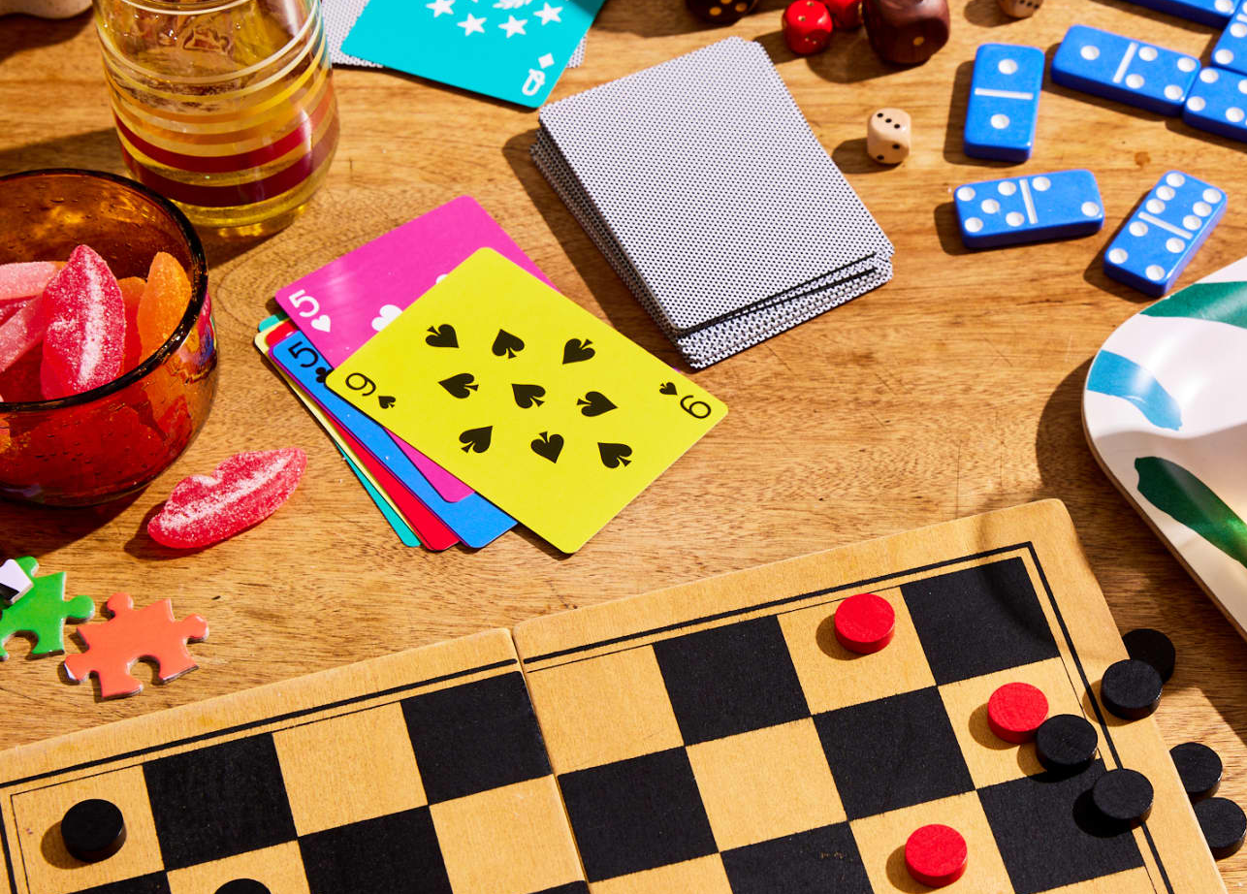
Board Game Data
Group 2
STOR 320 - Final Project

Slide 2


1.
Introduction + Data
Notes:
You might think that board game popularity is declining as our lives become increasingly centered around technology. However, the global market size is estimated to reach $29.7 billion in 2028.

Slide 3

The Data
boardgamegeek.com
Scraped and uploaded to Kaggle by users Lime and ZakWhite in January 13, 2020
52 columns
20,000 rows
Notes:
For all of these board game enthusiasts, BoardGameGeek, or BGG, is a community-driven website where two million registered users, known as ‘Geeks’, can review, comment, and vote on over 120,000 board games. Our data set originates from Kaggle, collected by data scientists Lime and ZakWhite, and features the top 20,000 board games, with 52 variables, as of January 2020.

Slide 4
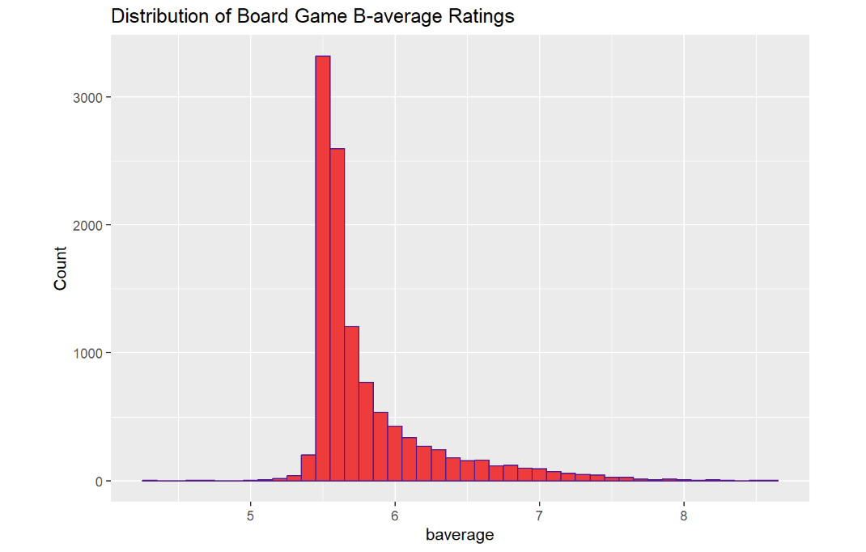
Response Variable
Notes:
We focused on predicting the variable baverage, which represents user ratings on a scale of 1 to 10 with an anti-skew algorithm. Specifically, our primary question was: What board game aspects have the greatest influence on Geeks’ ratings, and what kind of board game would receive the highest ratings amongst Geeks?

Slide 5
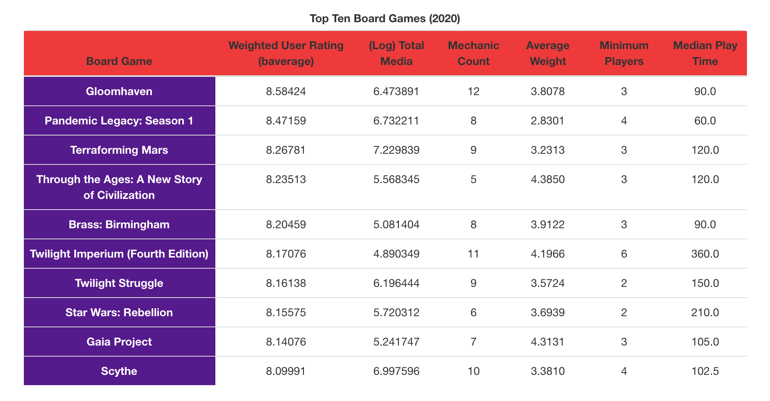
Top Ten Games
Notes:
Let’s take a look at the board game variables through the lens of the highest rated board game: Gloomhaven

Slide 6
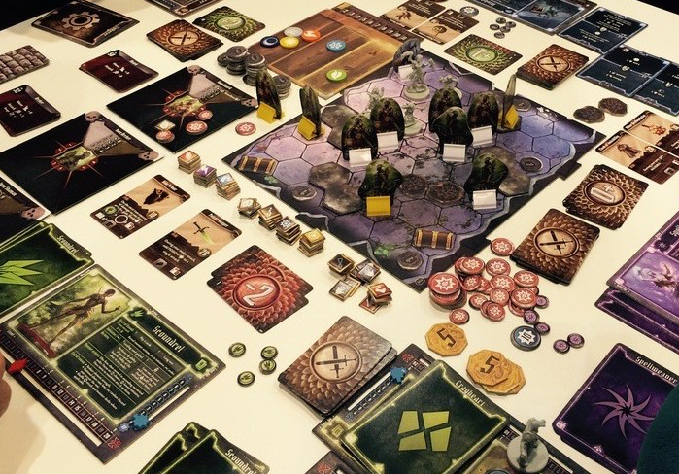
Gloomhaven
Notes:
, an epic fantasy game where players explore the town of Gloomhaven using cards and tactical combat to fight off monsters. Geeks rated Gloomhaven an 8.6/10 and the board game has a log total media of 6.47. To calculate media, we took the sum of the four types of media representation of board games: news, blogs, weblinks, and podcasts and took a log transformation of that. The game has 12 mechanics and an average weight of 3.8/5.0, which signifies a high complexity rating. Gloomhaven also requires a minimum of 3 players and has a median play time of about 90 minutes. Of these variables, we wanted to explore which ones helped catapult Gloomhaven all the way to the top ten.

Slide 7

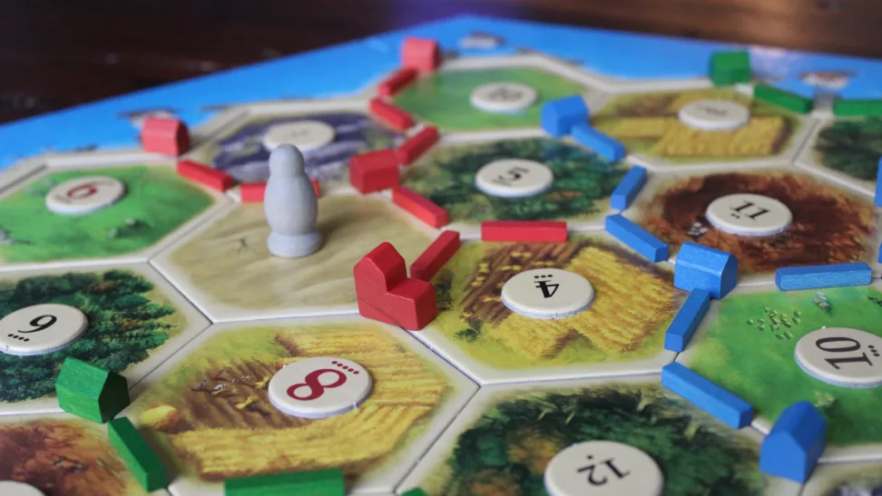
2.
Results
Notes:
Through initial modeling, we found the most significant variables were average weight, log total media, board game mechanic count, and mid play time. Although log total media is mostly relevant after board games are published, we included it in initial modeling under the assumption that a developer could have some influence over media through marketing.

Slide 8
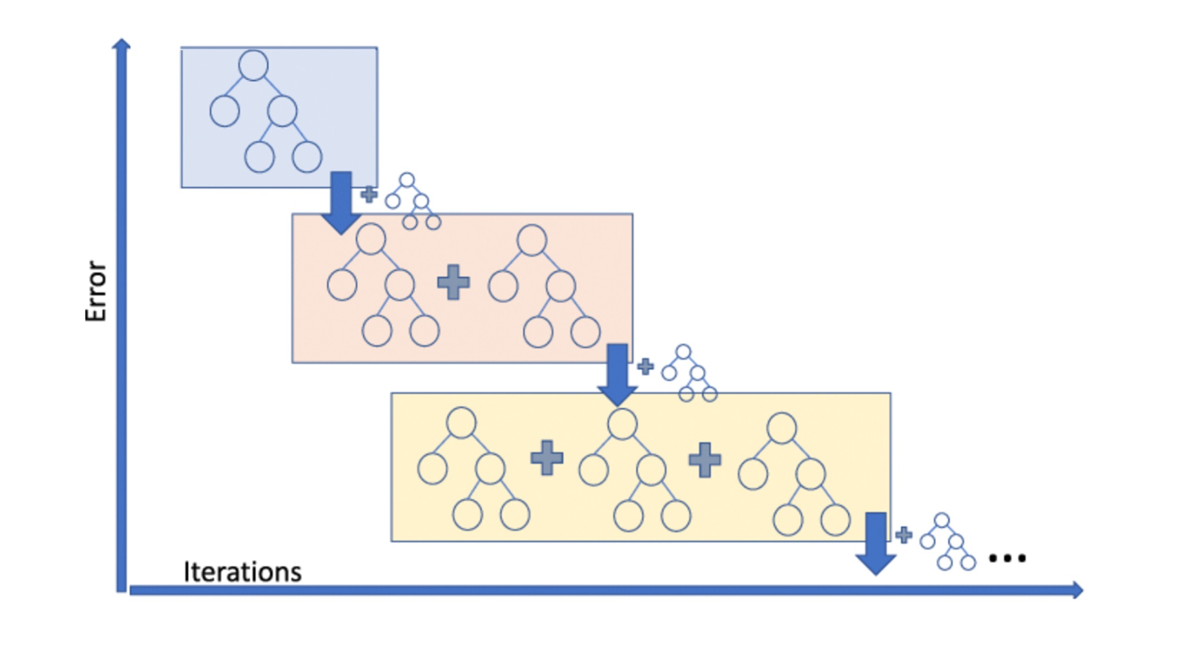
Gradient Boosting

Slide 9
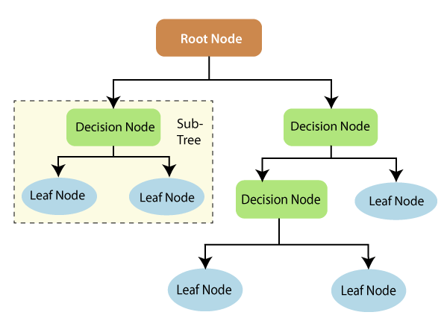
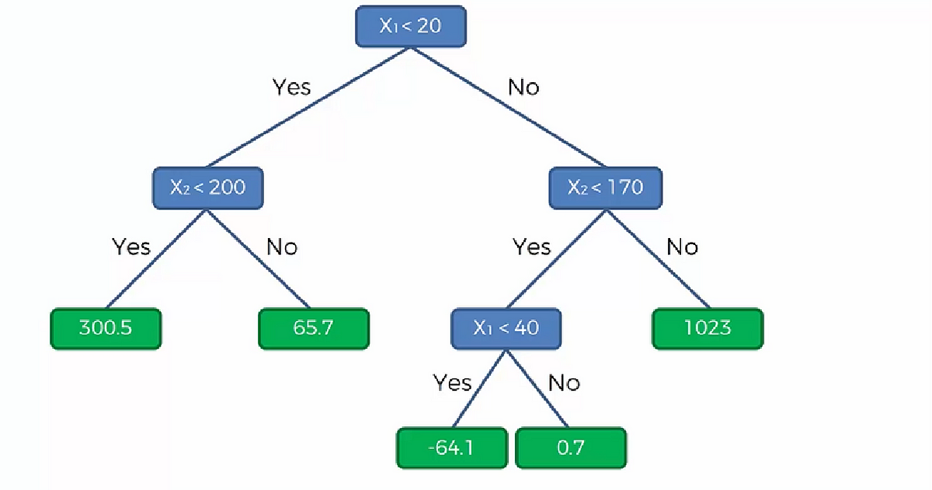
Decision Trees

Slide 10
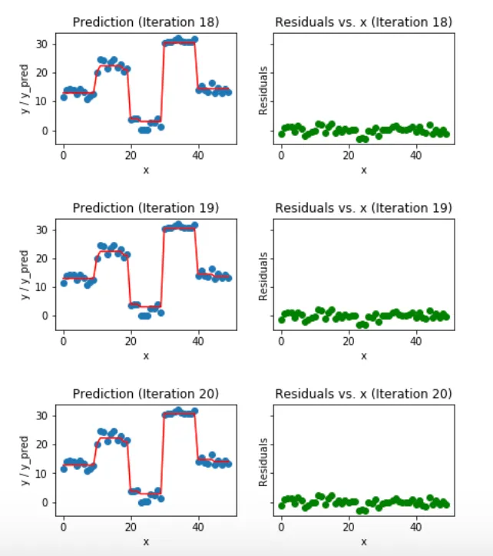
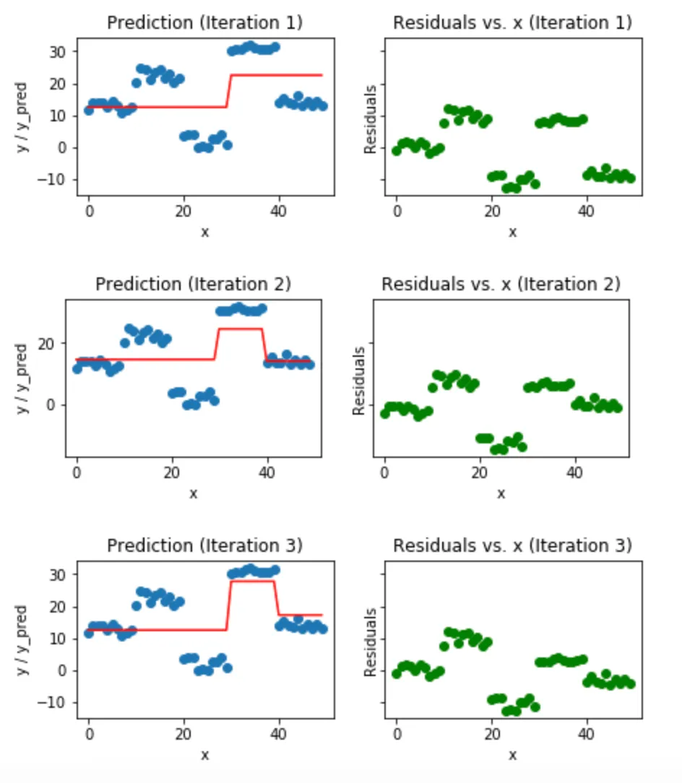
Subsequent Models Reduce Error!

Slide 11
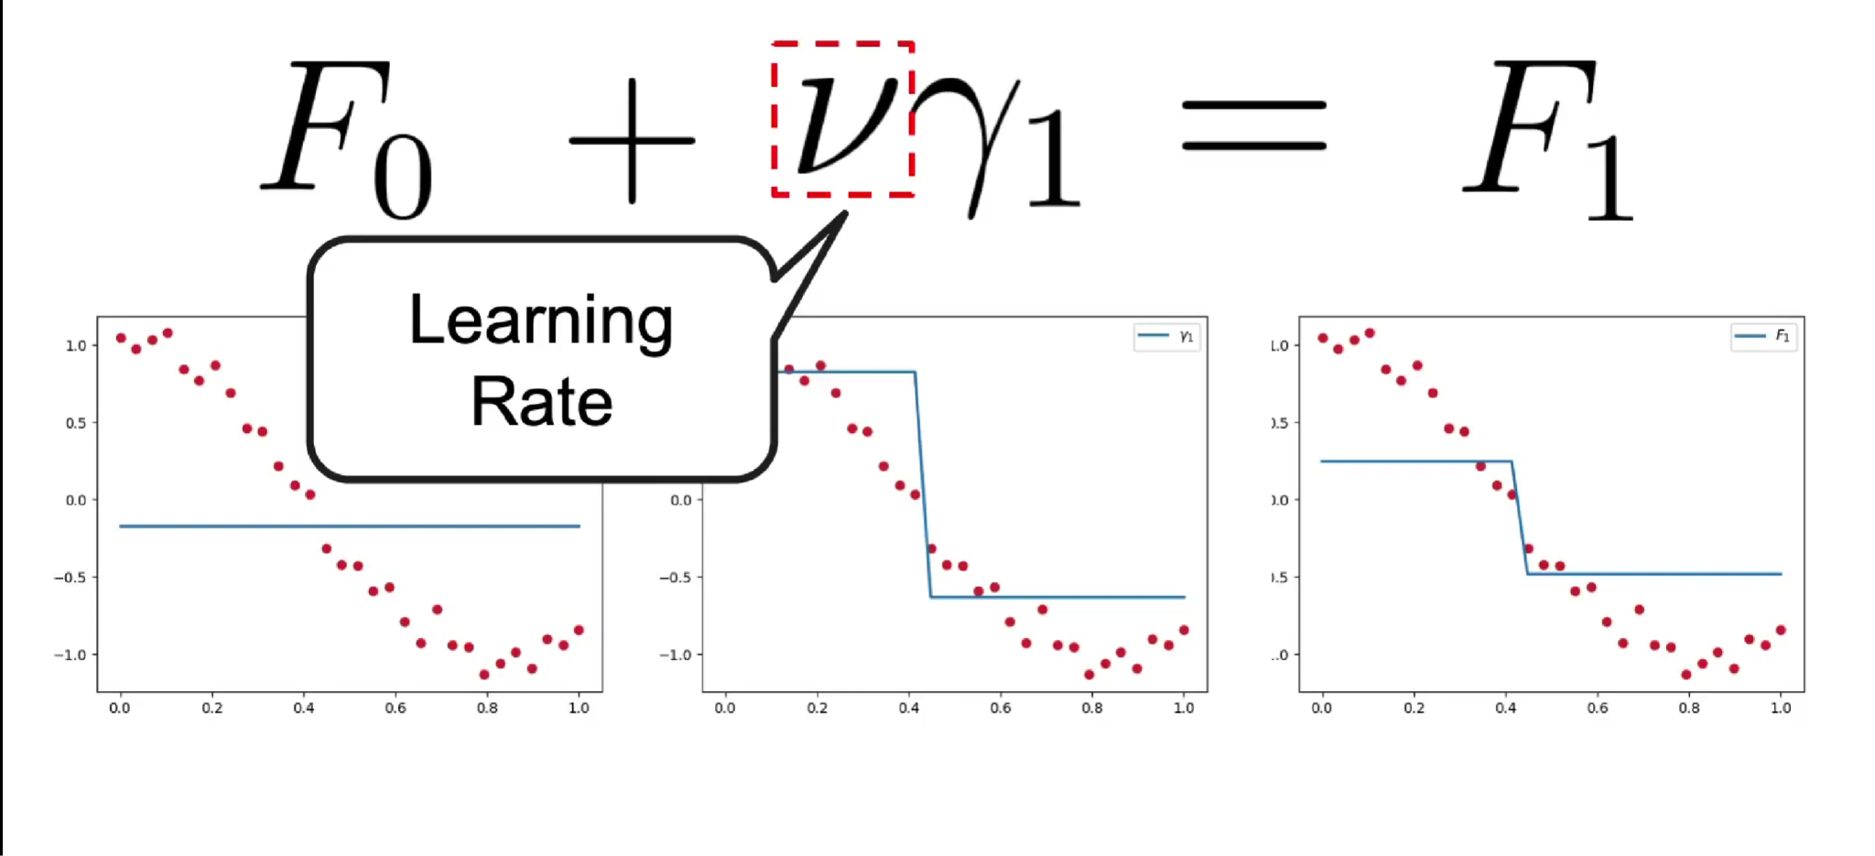
Learning Rate

Slide 12
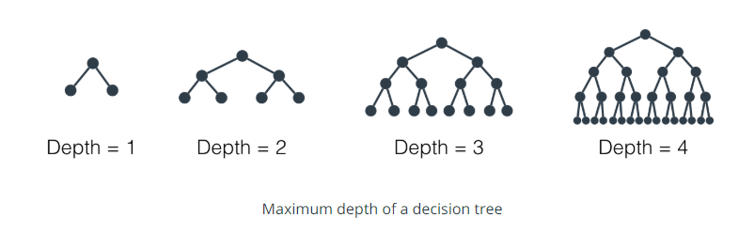
Tree Depth

Slide 13
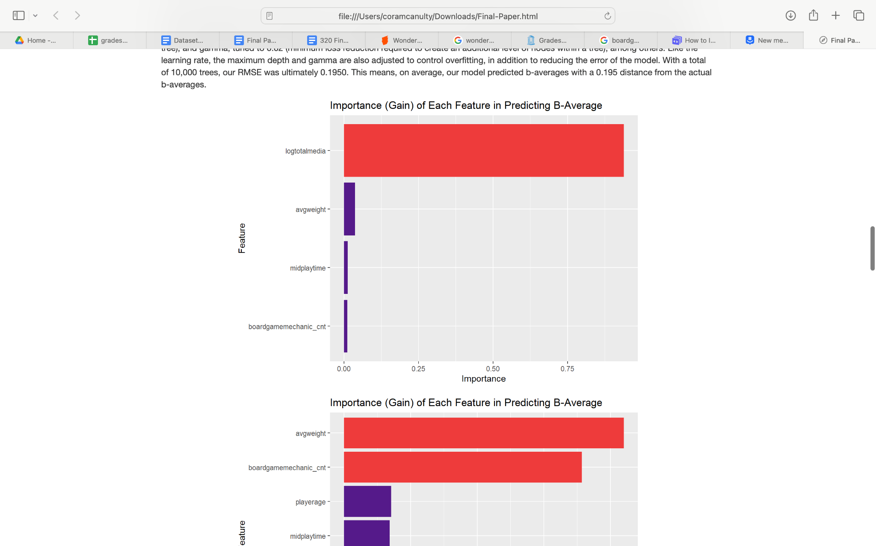
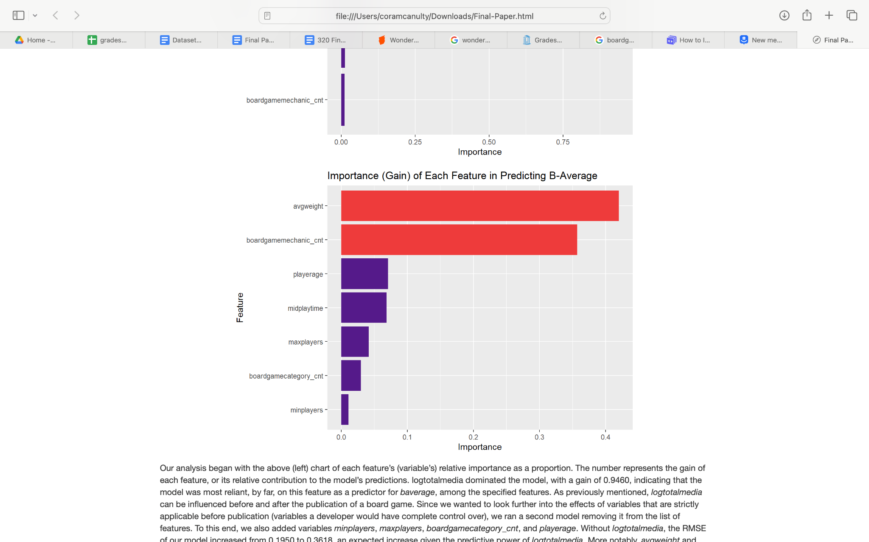
Variable Importance in Model
Without logtotalmedia
With logtotalmedia
Notes:
Our analysis began with this variable importance chart. The number represents the gain of each feature, or its relative contribution to the model’s predictions.
Log total media dominated the model, with a gain of 0.946, indicating that the model was most reliant on this feature as a predictor for baverage.
Average weight and mechanic count became the top two features in the new importance chart.
Without the predictive power of log total media, the RMSE of our model increased from 0.195 to 0.362.
Therefore, the second model used these two variables significantly more than the others to make its predictions, which makes sense — games with more mechanics have gameplay that is inherently more complex and nuanced. This suggests board gamers care more about complexity and mechanics compared to other variables. Our hypothetical developer may want to adopt this mindset as well.
However, this model does not indicate how these two variables influence the predicted baverage, only to what extent they do. To investigate this, we created partial dependence plots of the top two features.

Slide 14
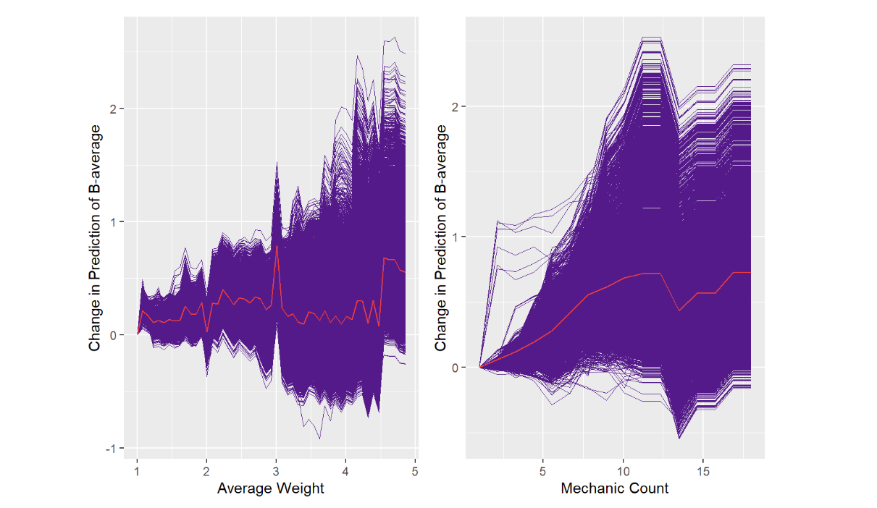
PDPs
(Partial Dependence Plots)

Slide 15
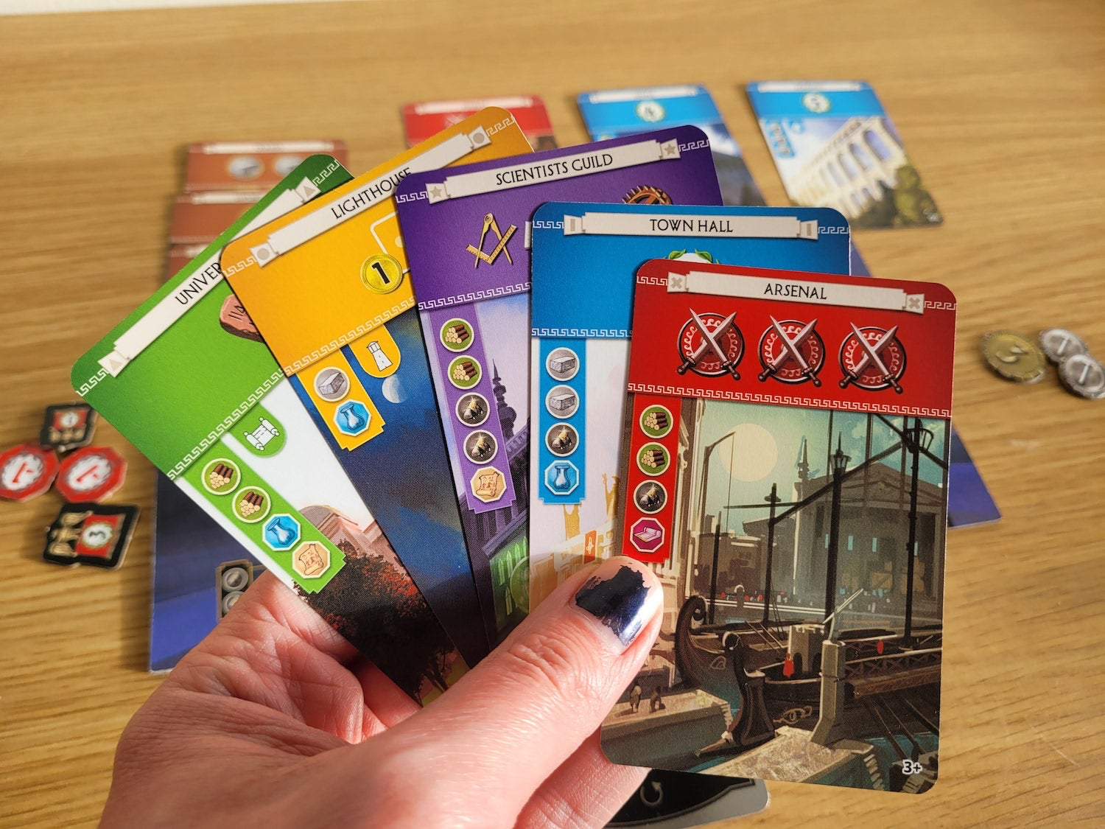
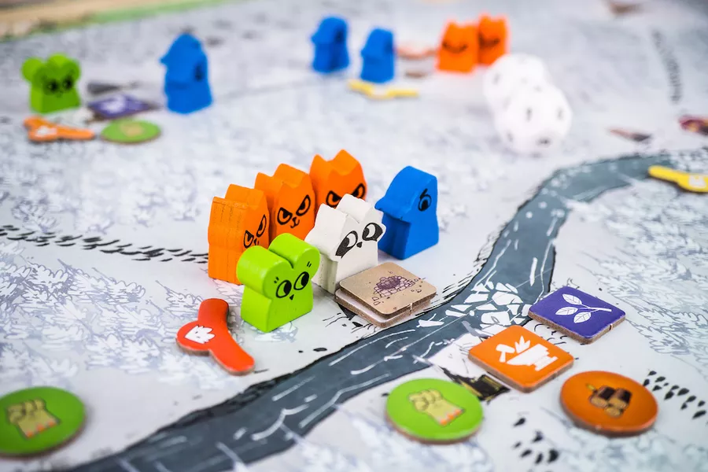

3.
Conclusion
Notes:
One limitation is that our data does only focus on Geek opinions and may leave out opinions of more casual board gamers. Nonetheless, our findings offer evidence that suggests complexity rating and mechanic count should be among the most important aspects for a board game developer to consider.

Slide 16



